Slide 1


Server Management For Insurance Website
BHARATI VIDYAPEETH (DEEMED UNIVERSITY)
COLLEGE OF ENGINEERING, PUNE
DEPARTMENT OF INFORMATION TECHNOLOGY
SEMESTER - 04
BY :-
Premansh Khandare Anjanikumar Choubey
Dhairya Shandilya Umair Ahmed

Slide 2
WHAT IS ITM AND ITS SCOPE :-​
BHARATI VIDYAPEETH (DEEMED UNIVERSITY)
COLLEGE OF ENGINEERING, PUNE
DEPARTMENT OF INFORMATION TECHNOLOGY
SEMESTER - 04
It infrastructure management (itm) refers to the process of overseeing the entire spectrum of an organization's information technology (it) infrastructure, ensuring that it is effectively utilized, maintained, and optimized to support the organization's objectives. This encompasses various components, including hardware, software, networks, data centers, cloud services, and other it resources.​
Key aspects of it infrastructure management include:​
Hardware management: ​
This involves managing physical devices such as servers, storage systems, networking equipment, and end-user devices like desktops, laptops, and mobile devices. It includes tasks such as procurement, installation, configuration, maintenance, and upgrades.​

Slide 3
WHAT IS ITM AND ITS SCOPE :-​
BHARATI VIDYAPEETH (DEEMED UNIVERSITY)
COLLEGE OF ENGINEERING, PUNE
DEPARTMENT OF INFORMATION TECHNOLOGY
SEMESTER - 04
Software management: ​
This includes managing the lifecycle of software applications and systems, including installation, configuration, patch management, license management, and ensuring compliance with licensing agreements.​
Data center management: ​
For organizations that maintain their own data centers, IT infrastructure management includes tasks such as provisioning and managing server and storage resources, ensuring uptime and availability, implementing disaster recovery and backup solutions, and optimizing energy efficiency.​

Slide 4
WHAT IS ITM AND ITS SCOPE :-​
BHARATI VIDYAPEETH (DEEMED UNIVERSITY)
COLLEGE OF ENGINEERING, PUNE
DEPARTMENT OF INFORMATION TECHNOLOGY
SEMESTER - 04
Cloud management: ​
With the increasing adoption of cloud services, IT infrastructure management also involves managing cloud resources, including infrastructure as a service (iaas), platform as a service (paas), and software as a service (saas) offerings. This includes tasks such as provisioning and scaling cloud resources, monitoring usage and costs, and ensuring compliance and security in the cloud environment.​
Security Management: ​
IT infrastructure management includes implementing and maintaining security measures to protect the organization's IT assets from various threats, including cyberattacks, data breaches, malware, and unauthorized access. This involves tasks such as implementing security policies and procedures, conducting risk assessments, deploying security technologies (e.g., Firewalls, antivirus software, intrusion detection systems), and ensuring compliance with regulatory requirements.​

Slide 5
WHAT IS ITM AND ITS SCOPE :-​
BHARATI VIDYAPEETH (DEEMED UNIVERSITY)
COLLEGE OF ENGINEERING, PUNE
DEPARTMENT OF INFORMATION TECHNOLOGY
SEMESTER - 04
Compliance and governance: ​
Ensuring compliance with relevant regulations, standards, and internal policies is essential for IT infrastructure management. This includes compliance with data protection regulations, industry standards (e.g., PCI DSS, HIPAA), and internal governance frameworks. IT infrastructure managers must establish controls, conduct audits, and implement measures to ensure compliance and mitigate risks.
Capacity planning and scalability: ​
IT infrastructure managers need to anticipate future needs and plan for the scalability and growth of IT infrastructure resources. This involves capacity planning, forecasting demand, scaling resources up or down as needed, and optimizing resource utilization to meet business requirements efficiently.

Slide 6
WHAT IS ITM AND ITS SCOPE :-​
BHARATI VIDYAPEETH (DEEMED UNIVERSITY)
COLLEGE OF ENGINEERING, PUNE
DEPARTMENT OF INFORMATION TECHNOLOGY
SEMESTER - 04
Vendor Management: ​
IT infrastructure managers often work with third-party vendors, suppliers, and service providers for hardware, software, and services. Managing vendor relationships, contracts, service level agreements (SLAs), and procurement processes is essential to ensure the smooth operation of IT infrastructure and services.​
Monitoring and Performance Management: ​
IT infrastructure managers are responsible for monitoring the health, performance, and availability of IT systems and services. This involves deploying monitoring tools, collecting and analyzing performance metrics, identifying bottlenecks or issues, and implementing optimizations to ensure optimal performance and reliability.​​

Slide 7
About our Website
BHARATI VIDYAPEETH (DEEMED UNIVERSITY)
COLLEGE OF ENGINEERING, PUNE
DEPARTMENT OF INFORMATION TECHNOLOGY
SEMESTER - 04
Insurancy Website is a multifaceted online platform offering a wide array of insurance products and services. Tailored to meet diverse needs, it encompasses various insurance categories such as auto, home, health, and travel. With its intuitive multipage structure, users can easily navigate through different sections to explore insurance options, obtain quotes, and initiate purchases. Key features include instant quote generation, claims processing, customer support channels, educational resources, and account management functionalities. Overall, the General Insurance Website serves as a centralized hub for individuals and businesses to conveniently access and manage their insurance needs online.

Slide 8
About our Website
BHARATI VIDYAPEETH (DEEMED UNIVERSITY)
COLLEGE OF ENGINEERING, PUNE
DEPARTMENT OF INFORMATION TECHNOLOGY
SEMESTER - 04
Features :-
Product Offering: Provides a range of insurance products such as auto insurance, home insurance, health insurance, life insurance, travel insurance, and more.
Quote Generation: Enables users to input their details and requirements to receive instant insurance quotes tailored to their needs.
Policy Comparison: Offers tools or tables for users to compare different insurance policies based on coverage, premiums, deductibles, and other parameters.

Slide 9
About our Website
BHARATI VIDYAPEETH (DEEMED UNIVERSITY)
COLLEGE OF ENGINEERING, PUNE
DEPARTMENT OF INFORMATION TECHNOLOGY
SEMESTER - 04
Features :-
Online Purchasing: Allows users to initiate and complete the purchase of insurance policies directly through the website, with secure payment options.
Claims Management: Provides facilities for users to report claims online, track the progress of claims processing, and submit relevant documentation electronically.
Customer Support: Offers various channels for customer support such as live chat, email, helpline, or online contact forms to address inquiries, concerns, and assistance needs.

Slide 10
About our Website
BHARATI VIDYAPEETH (DEEMED UNIVERSITY)
COLLEGE OF ENGINEERING, PUNE
DEPARTMENT OF INFORMATION TECHNOLOGY
SEMESTER - 04
Features :-
Educational Resources: Provides informative articles, guides, FAQs, and tools to help users understand insurance concepts, coverage options, and make informed decisions.
Policy Management: Allows registered users to manage their insurance policies, view policy details, make changes to coverage, update personal information, and renew policies online.
Document Access: Offers access to policy documents, certificates of insurance, invoices, and other relevant documents in digital format for easy retrieval and reference.

Slide 11
About our Website
BHARATI VIDYAPEETH (DEEMED UNIVERSITY)
COLLEGE OF ENGINEERING, PUNE
DEPARTMENT OF INFORMATION TECHNOLOGY
SEMESTER - 04
Features :-
Notifications and Reminders: Sends automated notifications and reminders to users for policy renewals, premium payments, and other important deadlines.
Personalized Recommendations: Utilizes user data and preferences to offer personalized insurance recommendations, discounts, and promotions.
Feedback and Reviews: Provides avenues for users to submit feedback, reviews, and ratings to help improve services and enhance user experience.

Slide 12
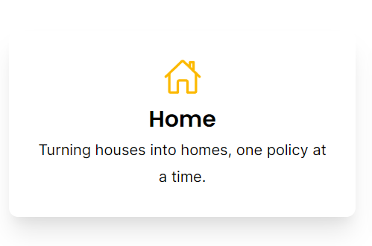
Our Offerings
BHARATI VIDYAPEETH (DEEMED UNIVERSITY)
COLLEGE OF ENGINEERING, PUNE
DEPARTMENT OF INFORMATION TECHNOLOGY
SEMESTER - 04
We offer a comprehensive range of insurance products tailored to meet diverse needs and requirements. Our insurance offerings include:-
Auto Insurance: Protecting vehicles against damage, theft, and liability in case of accidents.
Home Insurance: Safeguarding homes and belongings from risks such as fire, theft, natural disasters, and liability.
Health Insurance: Providing coverage for medical expenses, hospitalization, and healthcare services, ensuring financial security during illnesses or injuries.

Slide 13


Our Offerings
BHARATI VIDYAPEETH (DEEMED UNIVERSITY)
COLLEGE OF ENGINEERING, PUNE
DEPARTMENT OF INFORMATION TECHNOLOGY
SEMESTER - 04
Life Insurance: Offering financial protection to beneficiaries in the event of the policyholder's death, including term life, whole life, and universal life insurance options.
Travel Insurance: Ensuring coverage for unexpected events during domestic or international travel, including trip cancellation, medical emergencies, and lost luggage.
Business Insurance: Protecting businesses against various risks such as property damage, liability claims, business interruption, and employee-related risks.

Slide 14
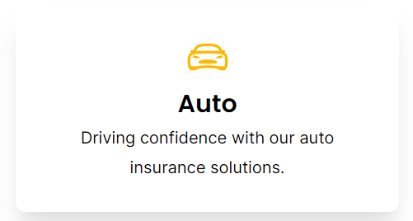
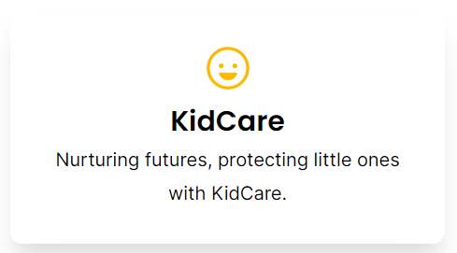
Our Offerings
BHARATI VIDYAPEETH (DEEMED UNIVERSITY)
COLLEGE OF ENGINEERING, PUNE
DEPARTMENT OF INFORMATION TECHNOLOGY
SEMESTER - 04
Disability Insurance: Offering income replacement for individuals unable to work due to disability or illness, ensuring financial stability during challenging times.
Liability Insurance: Covering legal liabilities arising from bodily injury, property damage, or personal injury claims against individuals or businesses.
Renter's Insurance: Protecting tenants' personal belongings and liability in rented properties against risks such as theft, fire, or water damage.

Slide 15
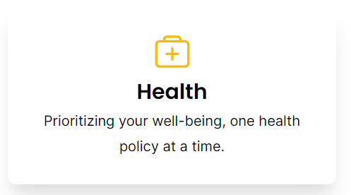
Our Offerings
BHARATI VIDYAPEETH (DEEMED UNIVERSITY)
COLLEGE OF ENGINEERING, PUNE
DEPARTMENT OF INFORMATION TECHNOLOGY
SEMESTER - 04
Boat and Watercraft Insurance: Ensuring coverage for boats, yachts, and other watercraft against damage, accidents, and liability on water bodies.
Specialty Insurance: Providing specialized coverage for unique risks, such as event insurance, cyber liability insurance, and professional liability insurance.
Umbrella Insurance: Offering additional liability coverage beyond the limits of primary insurance policies, providing extra protection against unforeseen events.

Slide 16
FAQs Feature
BHARATI VIDYAPEETH (DEEMED UNIVERSITY)
COLLEGE OF ENGINEERING, PUNE
DEPARTMENT OF INFORMATION TECHNOLOGY
SEMESTER - 04
Our insurance website incorporates a Frequently Asked Questions (FAQ) feature to provide users with quick and easy access to commonly asked questions and answers related to our products, services, and policies. The FAQ section serves as a valuable resource for users seeking information and clarification on various aspects of insurance coverage and our website functionalities.
Key features of our FAQ section include:
Comprehensive Coverage: The FAQ section covers a wide range of topics, including policy coverage details, premium payments, claims processing, eligibility criteria, and more, addressing common queries that users may have.
User-Friendly Interface: The FAQ section is designed with a user-friendly interface, allowing users to browse through questions categorically or search for specific topics using keywords or phrases.

Slide 17
FAQs Feature
BHARATI VIDYAPEETH (DEEMED UNIVERSITY)
COLLEGE OF ENGINEERING, PUNE
DEPARTMENT OF INFORMATION TECHNOLOGY
SEMESTER - 04
Clear and Concise Answers: Each FAQ entry provides clear and concise answers to the corresponding question, ensuring that users can easily understand the information provided.
Updated Information: We regularly update the FAQ section to incorporate new questions, address emerging concerns, and reflect any changes in policies or procedures, ensuring that users have access to the most up-to-date information.
Accessibility: The FAQ feature is accessible across various devices, including desktops, laptops, smartphones, and tablets, allowing users to access information conveniently at any time and from anywhere.
Feedback Mechanism: We encourage users to provide feedback on the FAQ section, allowing us to continuously improve and enhance the content based on user input and evolving needs.

Slide 18
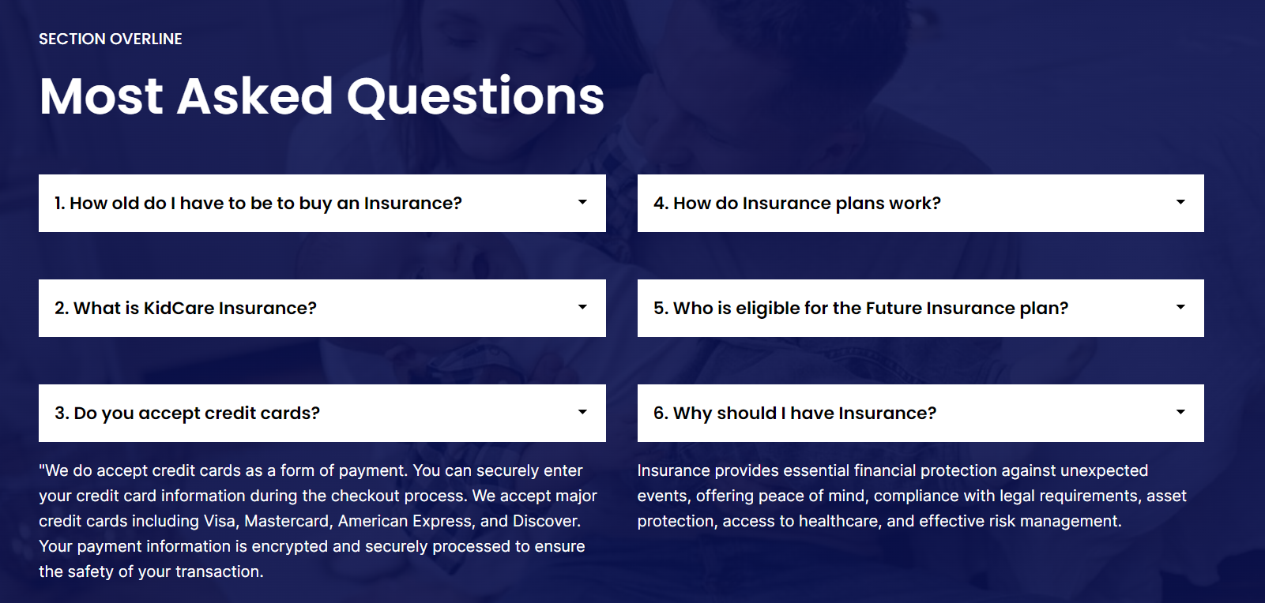
FAQs Feature
BHARATI VIDYAPEETH (DEEMED UNIVERSITY)
COLLEGE OF ENGINEERING, PUNE
DEPARTMENT OF INFORMATION TECHNOLOGY
SEMESTER - 04

Slide 19
Server Side of our Website
BHARATI VIDYAPEETH (DEEMED UNIVERSITY)
COLLEGE OF ENGINEERING, PUNE
DEPARTMENT OF INFORMATION TECHNOLOGY
SEMESTER - 04
On the server side of our insurance website, a crucial component is the integration of the user details form with an Excel sheet acting as our server. This integration facilitates the seamless collection and storage of user data submitted through the form. Upon submission, the server processes the incoming data, validating and securely storing it within the Excel sheet database. This server-side mechanism ensures efficient management of user information, allowing for easy retrieval and analysis as needed. Additionally, employing Excel as the server provides a cost-effective and accessible solution for handling data storage and retrieval tasks. With appropriate security measures in place, such as encryption and access controls, we maintain the confidentiality and integrity of user data, reinforcing trust and compliance with data protection regulations. Overall, the integration of the user details form with an Excel sheet on the server side optimizes data management processes, enhancing the functionality and reliability of our insurance website.

Slide 20
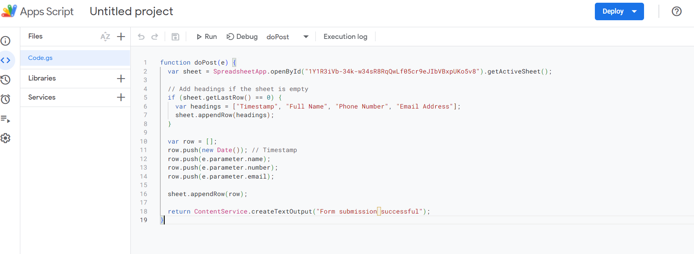
Server Side of our Website
BHARATI VIDYAPEETH (DEEMED UNIVERSITY)
COLLEGE OF ENGINEERING, PUNE
DEPARTMENT OF INFORMATION TECHNOLOGY
SEMESTER - 04
This is the code for the take the information from user and save their data.

Slide 21
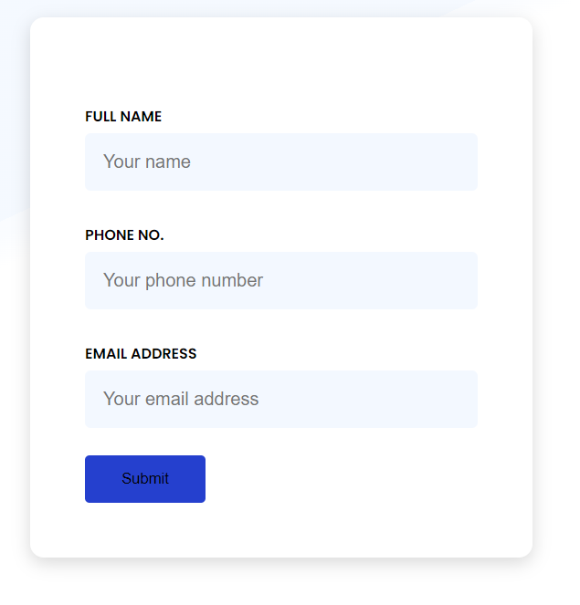
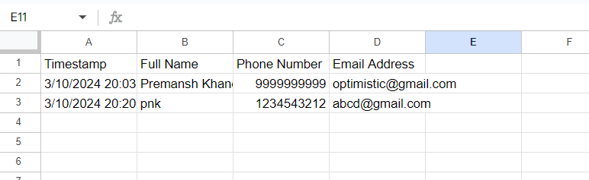
Server Side of our Website
BHARATI VIDYAPEETH (DEEMED UNIVERSITY)
COLLEGE OF ENGINEERING, PUNE
DEPARTMENT OF INFORMATION TECHNOLOGY
SEMESTER - 04
The user can fill the form and their information will store in this excel file.
All the data is safe and there is scalable and secure data of the user.

Slide 22
Advantages of Server Side
BHARATI VIDYAPEETH (DEEMED UNIVERSITY)
COLLEGE OF ENGINEERING, PUNE
DEPARTMENT OF INFORMATION TECHNOLOGY
SEMESTER - 04
In the context of our insurance website, implementing server-side functionalities offers numerous advantages that contribute to its functionality, security, and efficiency. Some of the key advantages of server-side processing include:
Data Security: By processing user data on the server side, we can implement robust security measures such as encryption, access controls, and regular security audits to safeguard sensitive information from unauthorized access, ensuring compliance with data protection regulations and maintaining user trust.
Centralized Data Management: Server-side processing allows for centralized storage and management of user data, ensuring consistency and reliability across the website. This centralized approach simplifies data retrieval, updates, and maintenance tasks, reducing the risk of data inconsistencies or errors.

Slide 23
Advantages of Server Side
BHARATI VIDYAPEETH (DEEMED UNIVERSITY)
COLLEGE OF ENGINEERING, PUNE
DEPARTMENT OF INFORMATION TECHNOLOGY
SEMESTER - 04
Scalability: Server-side processing enables us to scale our website infrastructure to accommodate growing user traffic and data volumes. By deploying scalable server resources, we can handle increased demand without compromising performance or user experience, ensuring seamless access to our services.
Customization and Personalization: Server-side processing enables us to tailor the user experience based on individual preferences, history, and interactions. By analyzing user data stored on the server, we can deliver personalized recommendations, content, and services, enhancing user engagement and satisfaction.
Improved Performance: Processing tasks on the server side reduces the workload on client devices, leading to improved website performance and responsiveness. By offloading resource-intensive computations and data processing tasks to server infrastructure, we can deliver faster load times and smoother user interactions, even on low-powered devices or slow internet connections.

Slide 24
Advantages of Server Side
BHARATI VIDYAPEETH (DEEMED UNIVERSITY)
COLLEGE OF ENGINEERING, PUNE
DEPARTMENT OF INFORMATION TECHNOLOGY
SEMESTER - 04
Cross-Platform Compatibility: Server-side processing ensures consistent functionality and performance across different devices and platforms. By handling complex computations and data processing tasks on the server, we can deliver a consistent user experience regardless of the user's device or operating system, enhancing accessibility and usability.
Enhanced Analytics and Insights: Server-side processing allows us to gather valuable insights into user behavior, preferences, and trends. By analyzing server logs and data collected during user interactions, we can identify patterns, optimize website performance, and make informed decisions to improve our services and offerings.

Slide 25
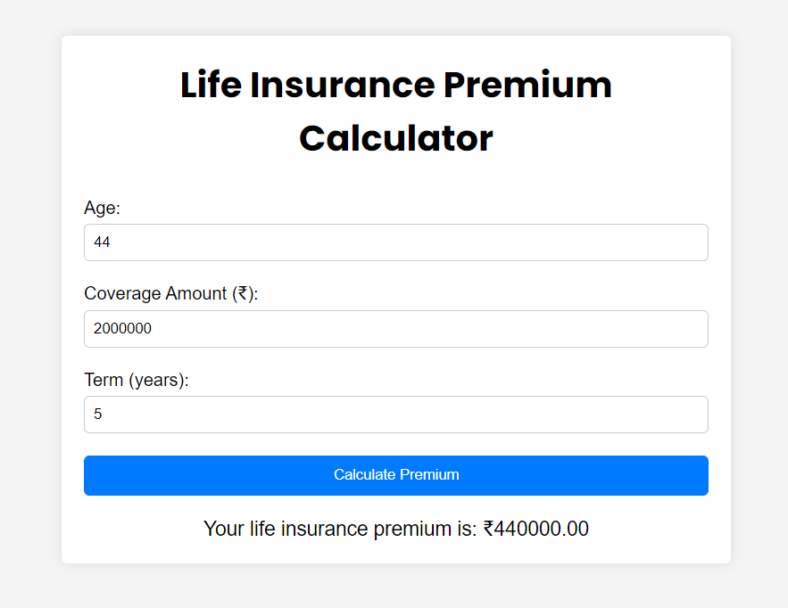
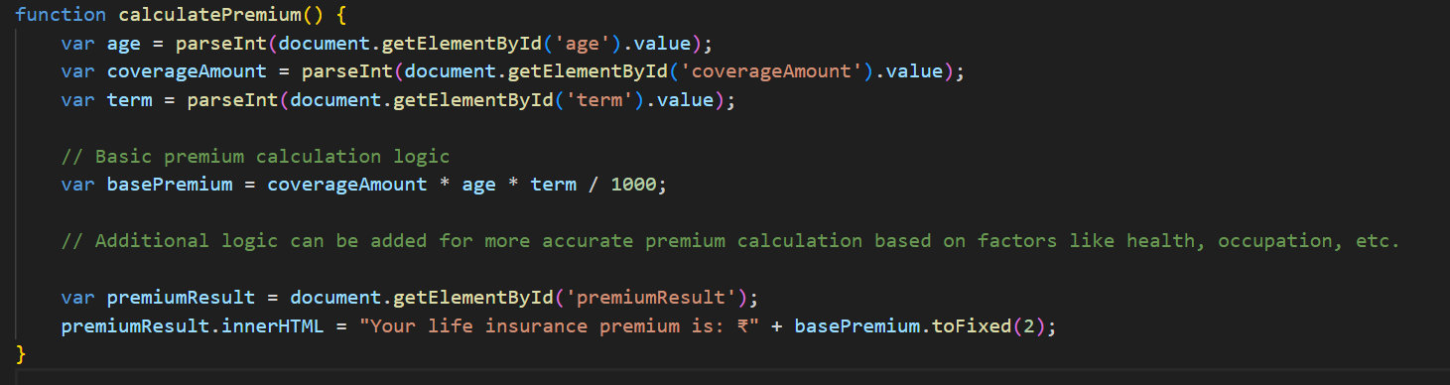
Insurance Premium Calculator
BHARATI VIDYAPEETH (DEEMED UNIVERSITY)
COLLEGE OF ENGINEERING, PUNE
DEPARTMENT OF INFORMATION TECHNOLOGY
SEMESTER - 04
The amount need to pay by the user is going to calculate here for the their insurance.
And the amount will be based on the user coverage amount and for the year they wanted it.

Slide 26
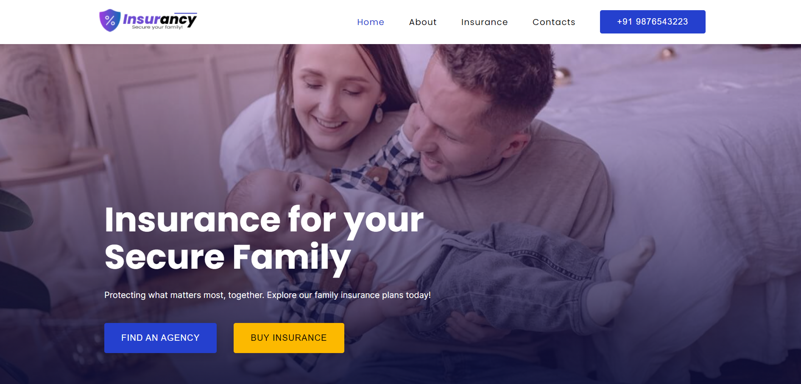
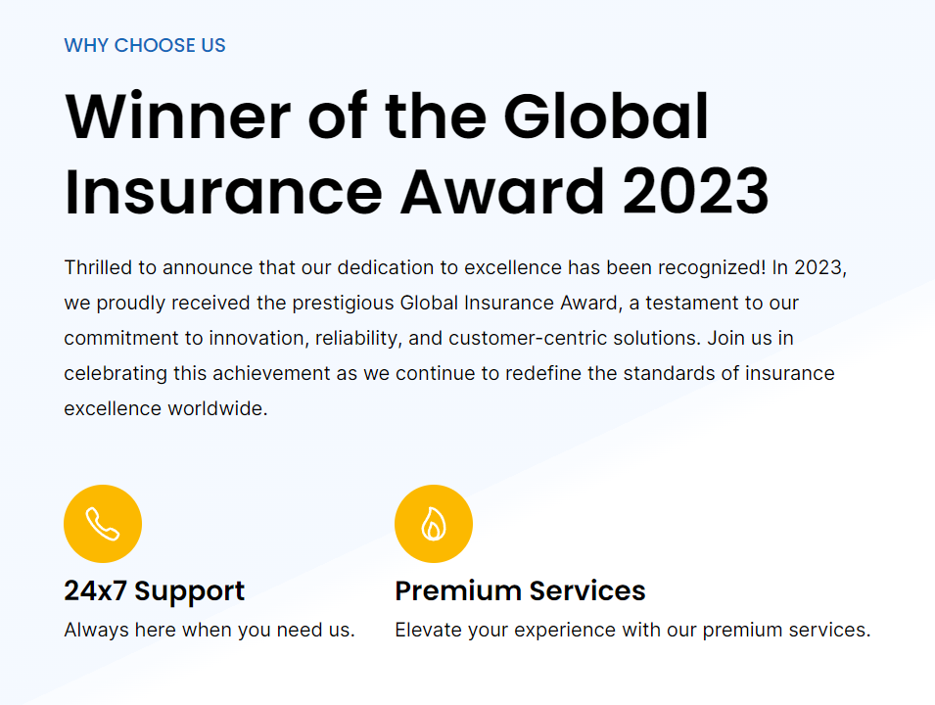
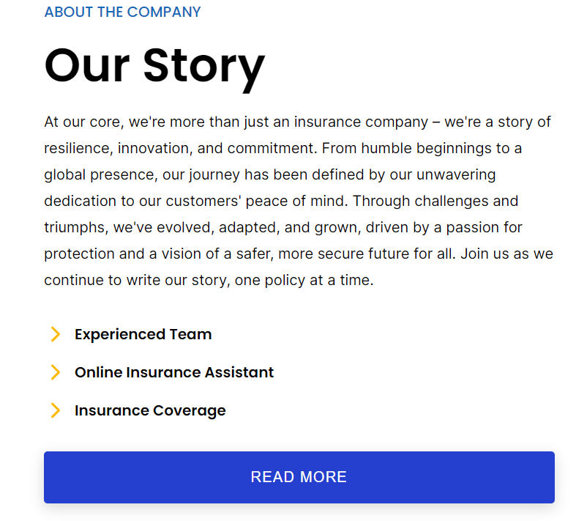

Handouts
BHARATI VIDYAPEETH (DEEMED UNIVERSITY)
COLLEGE OF ENGINEERING, PUNE
DEPARTMENT OF INFORMATION TECHNOLOGY
SEMESTER - 04

Slide 27
Thank You
BHARATI VIDYAPEETH (DEEMED UNIVERSITY)
COLLEGE OF ENGINEERING, PUNE
DEPARTMENT OF INFORMATION TECHNOLOGY
SEMESTER - 04

